Slide 1

Phishing Attacks

Slide 2
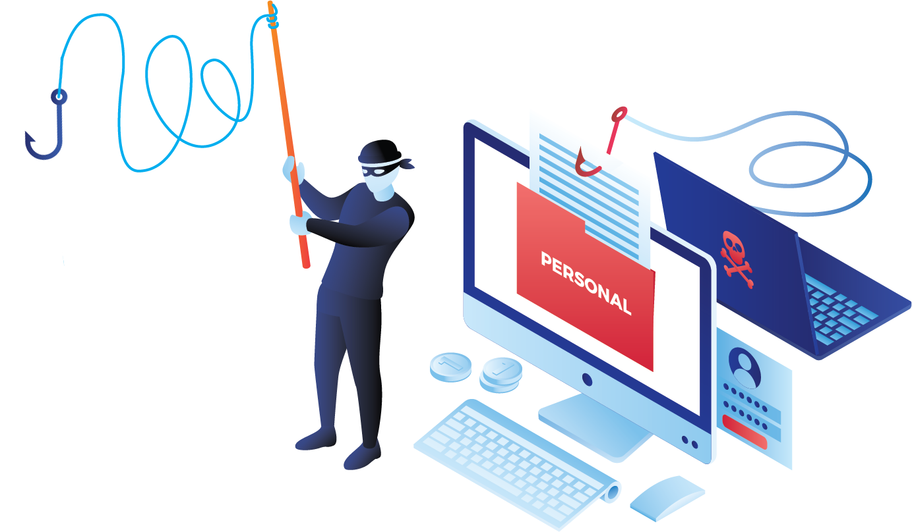
Phishing
When Scammers fool you to think they are someone you trust in order to make you do something.

Slide 3

7 Types of Phishing Scams You Should Know About

Slide 4
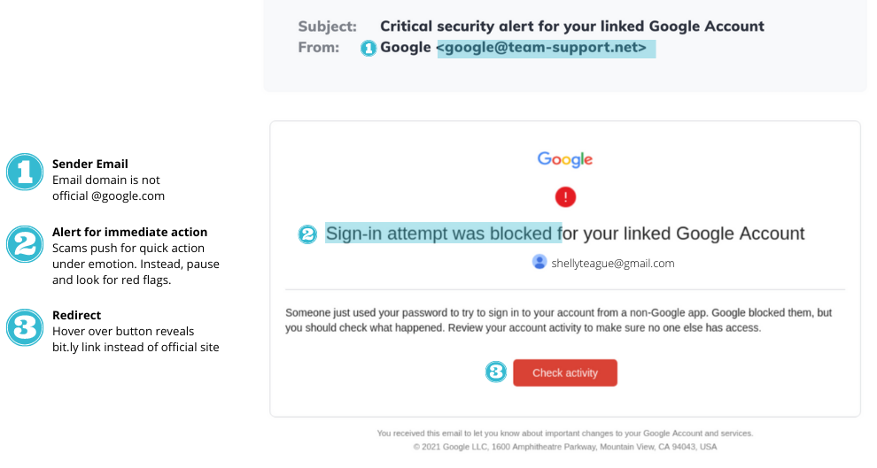
Email Phishing Scams
It may look like an email from your bank, Paypal, Google, Amazon, or even your CEO.

Slide 5
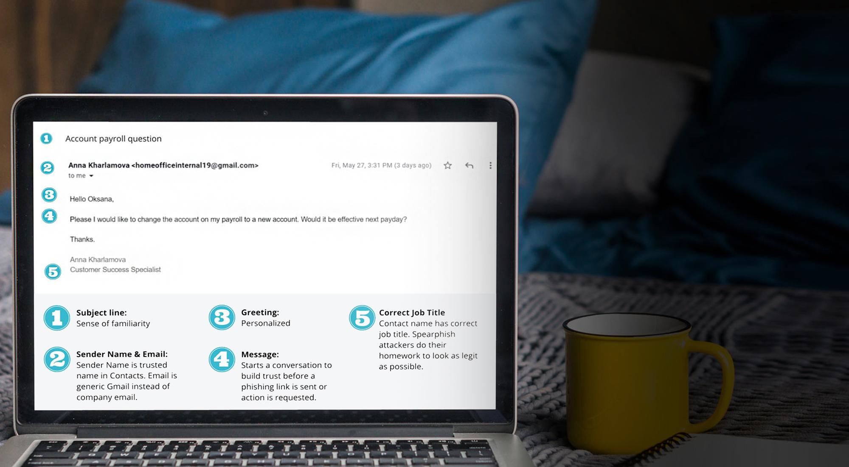
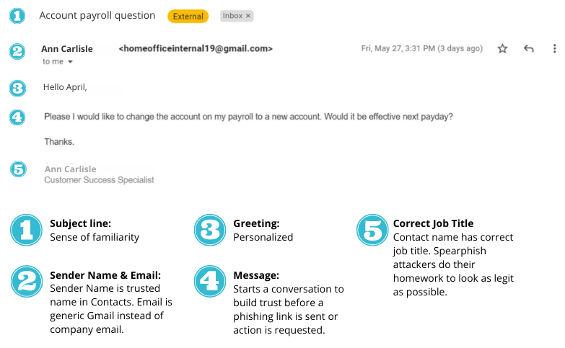
Spear Phishing Scams
This is when they target you specifically. They have researched you, they know your family members, where you work, and who is your boss. The chances of fooling you are higher.

Slide 6
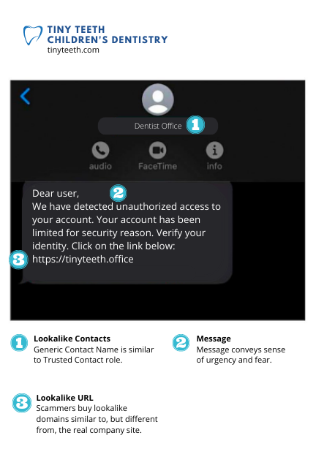
Smishing
Scams
These are text message phishing scams. Criminals know people respond to text and instant messages faster than email.

Slide 7
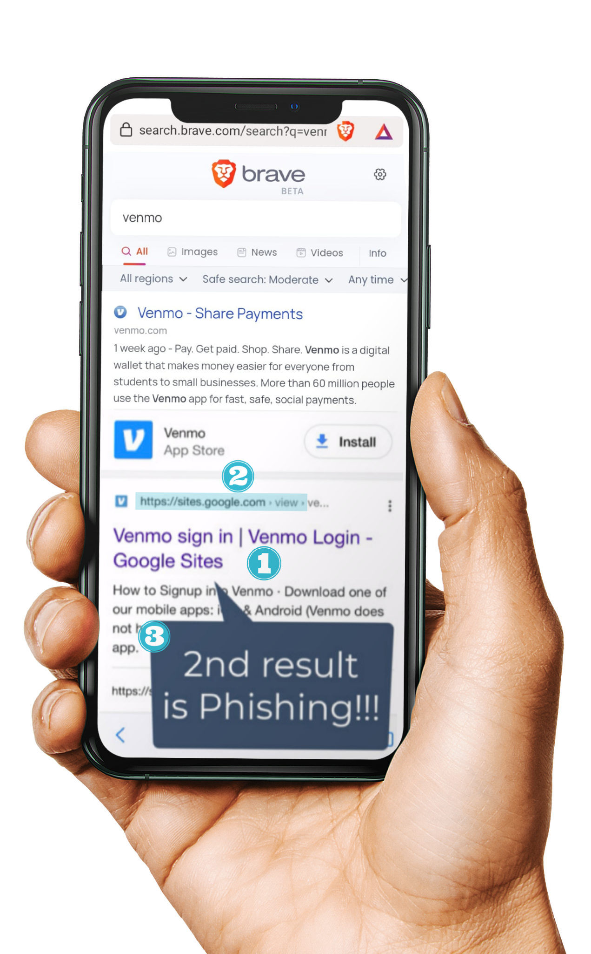



Google
Search
Scams
Search Result Shows Brand
Title displays correct brand name
You may be surprised, but some of the top search results in Google are phishing links.
Scammers also invest in search engine optimization and work hard to rank their scam sites in the top search results.
URL Mismatch
Title says Venmo but URL is a generic sites.google.com
2nd Result for Organic Search
Even top search results can be manipulated for fake sites

Slide 8
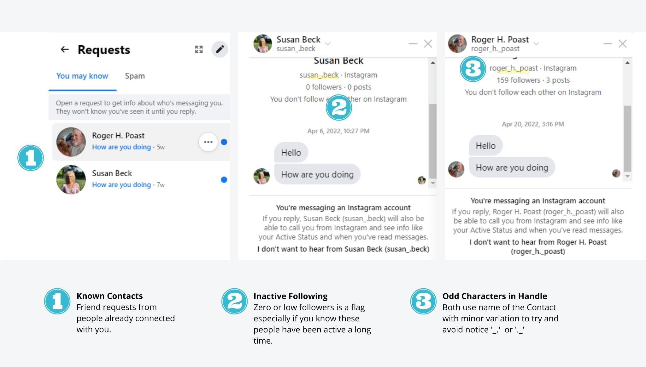
Social Media Scams
Social media is full
of fake accounts.
It could also be a fake account with the same name and photo as one of your real friends that will later try to scam you.

Slide 9
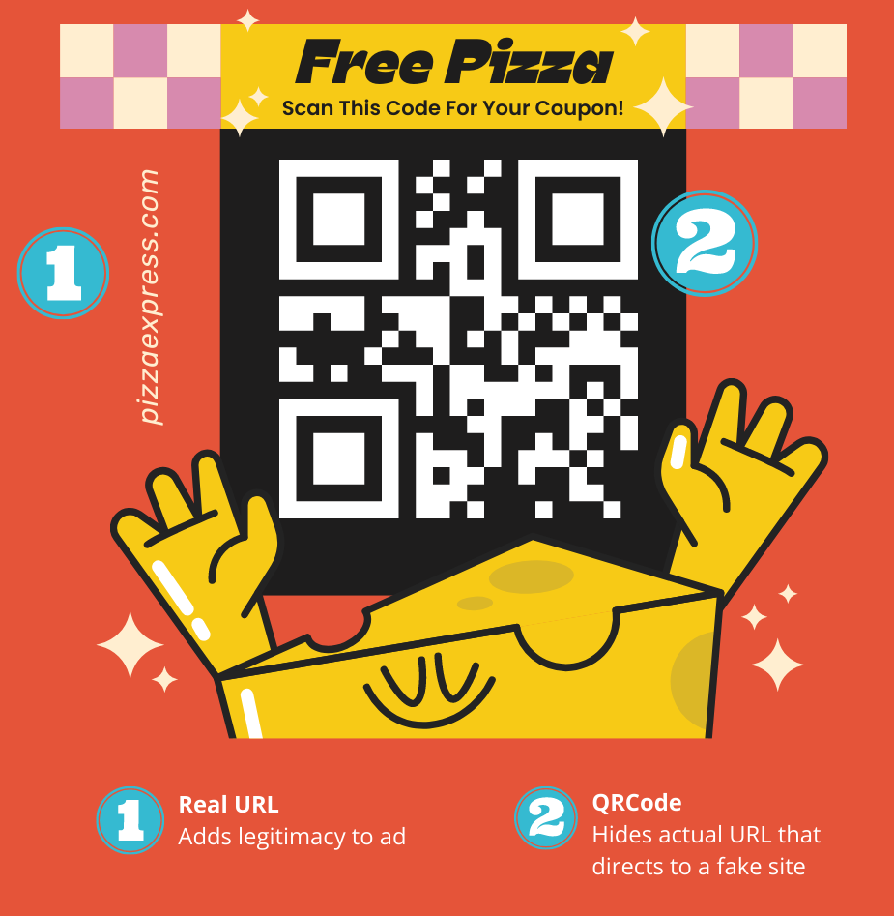
QR Code Scams
Who thought a QR code could be dangerous?
They are everywhere, especially in restaurants. Criminals can place their own sticker over the legitimate one. So that when you scan it, you will be redirected to a fake site.

Slide 10
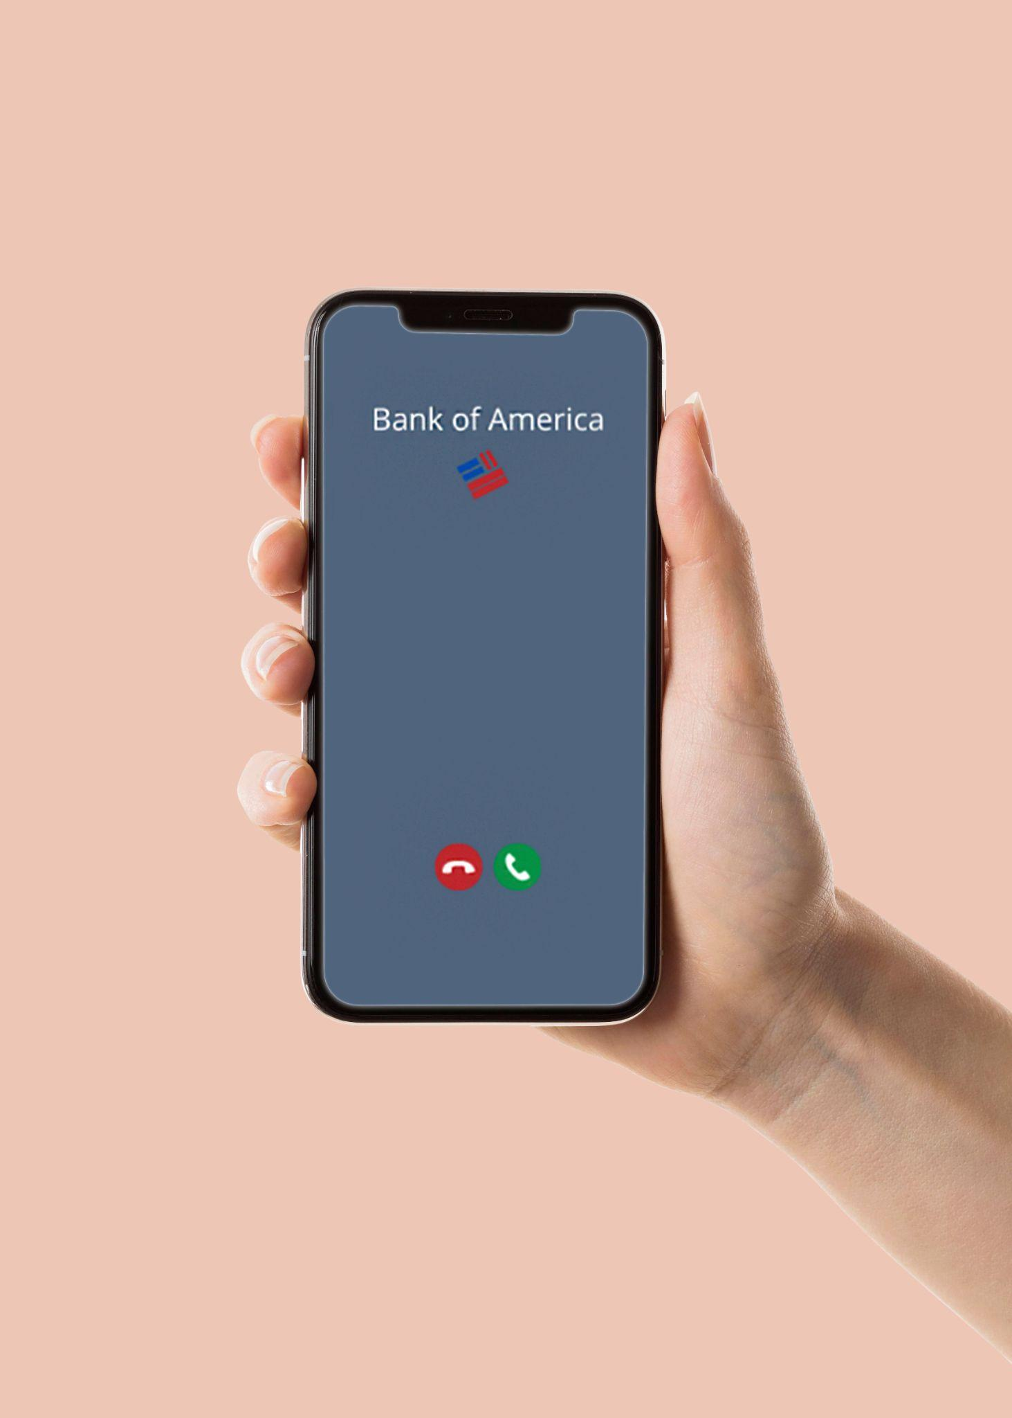


Vishing Scams
Vishing (voice phishing) is a type of phishing attack made over the telephone. Scammers can spoof a phone number that looks identical to a known number, like your bank.
Trusted Brands
Numbers for personal and commercial contacts can be spoofed.

Slide 11
What Helps Protect You From Phishing Attacks?
If it’s urgent, don’t let the emotions cloud your judgment
Call and verify! - Verify that you are talking to the correct person
Check the address - Always check the email address and URL for spelling mistakes
Enable Multi-Factor Authentication
Look at the style of the message
Ask questions

